Slide 1
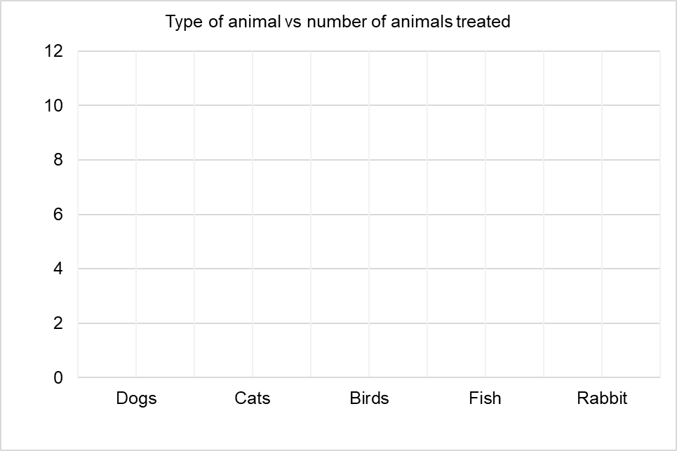
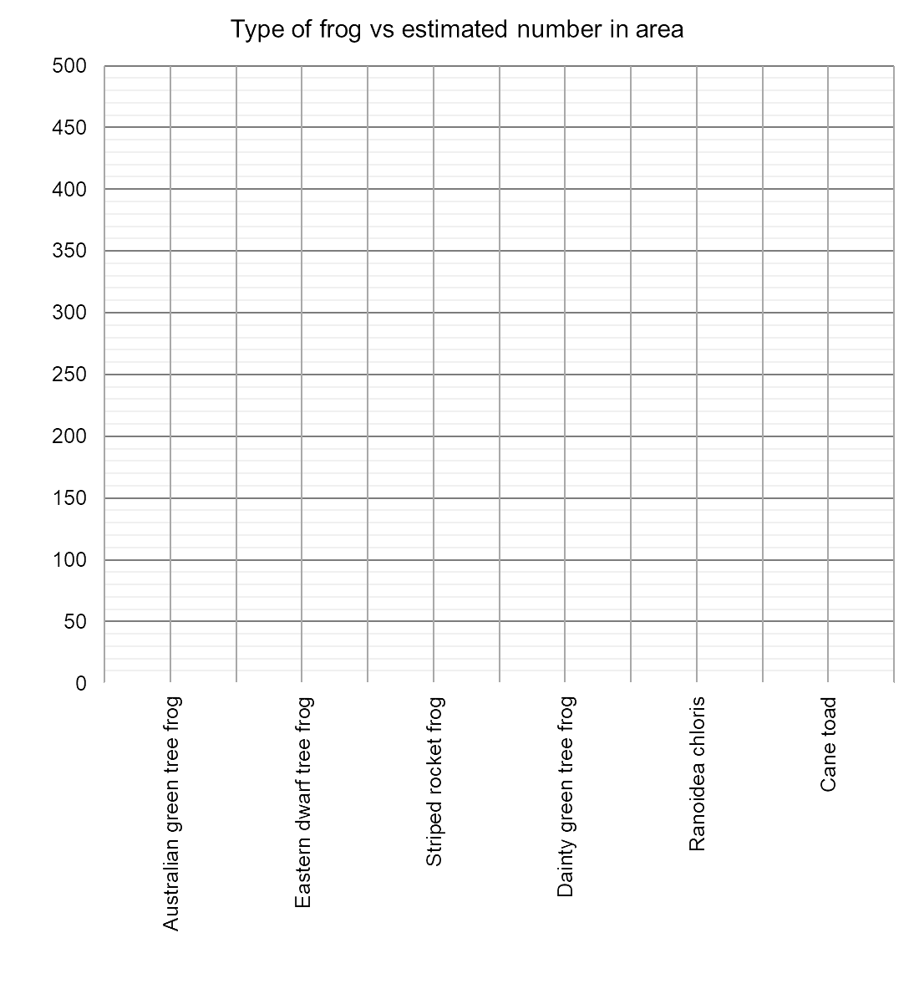
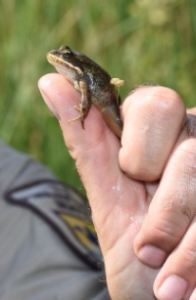
Scientific Plotting – Column Graphs
Name: _________________________
Q1. A veterinary nurse kept a record of the animals they treated on Wednesday. Complete the column graph below. Include the axis labels.
Q2. As part of their research, an ecological surveyor is determining the number of frogs in an area that is proposed for development. The data below summarises the types and numbers of frogs that they have counted. Draw a column graph to display this data.
Animal | Number of animals treated
Dogs | 11
Cats | 5
Birds | 2
Fish | 1
Rabbit | 5
Type of Frog | Estimated Number of Frogs in Area
Australian green tree frog | 211
Eastern dwarf tree frog | 473
Striped rocket frog | 426
Dainty green tree frog | 300
Ranoidea chloris | 476
Cane toad | 354

Slide 2
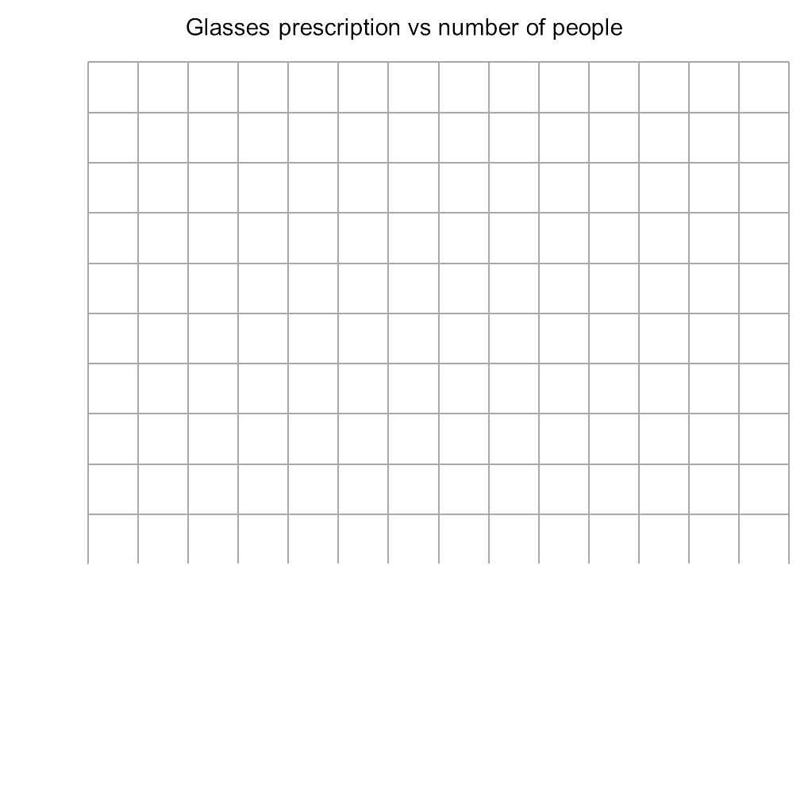
Q3. An optometrist is doing research on the glasses prescriptions of the customers who have come in to get their eyes tested. This data collected after one week is summarised in the table below. Plot the data as a column graph.
Glasses Prescription | Number of People
Less than 1.5 | 13
Between 1.5 and 2.5 | 16
Between 2.5 and 3.5 | 18
Between 3.5 and 4.5 | 10
Between 4.5 and 5.5 | 14
Between 5.5 and 6.5 | 19
Greater than 6.5 | 8

Slide 3
